Slide 1
Spark your idea

Slide 2
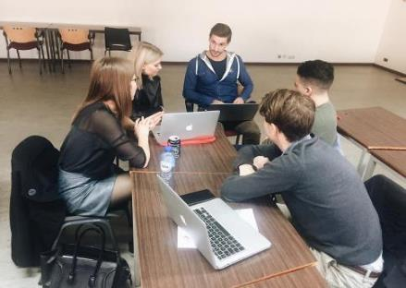
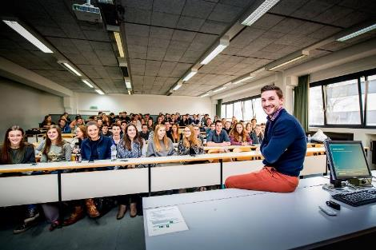
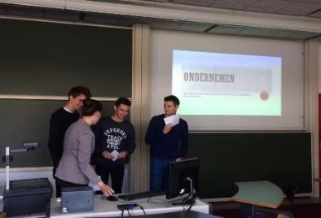
Wie ben ik?

Slide 3


Slide 4
Idee? Opportuniteit?

Slide 5
Wat is een opportuniteit?
Een idee een opportuniteit
Ideeën hebben geen concrete waarde, opportuniteiten wel
Voor ideeën heb je inspiratie nodig, voor opportuniteiten tijd en inspanning
Ideeën komen veel meer voor, je kan slechts 1 à 2 opportuniteiten nastreven
Bij ideeën mag je dromen, bij opportuniteiten moet je concrete gegevens hebben
Ideeën worden niet ondersteund door investeerders, opportuniteiten wel
Ideeën vormen basis voor ontdekken van opportuniteiten, opportuniteiten de basis voor een ondernemersinitiatief

Slide 6


Slide 7
De wonderlijke avonturen van het ontdekken van uw klanten

Slide 8


Belang Value Proposition Canvas
Product-market fit
Fit
Waardecreatie
Klanten observeren

Slide 9
Value Proposition Canvas
Value map
Customer profile

Slide 10
Value Proposition for Tesla
Customer Segment: Tesla Buyer
Upper Middle Class
Male
Higher income
Commute to work
Convey an image of success
Differentiate from others
Occasionally travel long distances
Be in sync with personal values

Slide 11
Value Proposition for Tesla
Customer Segment: Tesla Buyer
Upper Middle Class
Male
Higher income
Commute to work
Convey an image of success
Differentiate from others
Occasionally travel long distances
Be in sync with personal values
Long recharging time
Frequent recharging
Geeky perception
Lack of space
Fear of dead battery

Slide 12
Value Proposition for Tesla
Customer Segment: Tesla Buyer
Upper Middle Class
Male
Higher income
Perform like a sports car
Commute to work
Convey an image of success
Attractive design
Differentiate from others
Long range: +300 km
Occasionally travel long distances
High safety ratings
Be in sync with personal values
Always up-to-date features
Long recharging time
Frequent recharging
Geeky perception
Lack of space
Fear of dead battery

Slide 13
Value Proposition for Tesla
Customer Segment: Tesla Buyer
Upper Middle Class
Male
Higher income
Perform like a sports car
Commute to work
Convey an image of success
High Performance
Luxury Electrical Car (Model S)
Attractive design
Differentiate from others
Long range: +300 km
Occasionally travel long distances
High safety ratings
Be in sync with personal values
Always up-to-date features
Long recharging time
Frequent recharging
Geeky perception
Lack of space
Fear of dead battery

Slide 14
Value Proposition for Tesla
Customer Segment: Tesla Buyer
Upper Middle Class
Male
Higher income
Perform like a sports car
Commute to work
Convey an image of success
High Performance
Luxury Electrical Car (Model S)
Attractive design
Differentiate from others
Long range: +300 km
Occasionally travel long distances
High safety ratings
Be in sync with personal values
Always up-to-date features
Free charging at supercharger stations
High speed charging
Long recharging time
Frequent recharging
A luxury image
Geeky perception
Lack of space
High capacity battery
5+2 seats and a big trunk
Fear of dead battery

Slide 15
Value Proposition for Tesla
Customer Segment: Tesla Buyer
Upper Middle Class
Male
Higher income
0-100 km/h in 6 sec
Perform like a sports car
Commute to work
Award winning design
Convey an image of success
High Performance
Luxury Electrical Car (Model S)
Attractive design
Long range +450km
Differentiate from others
Long range: +300 km
Occasionally travel long distances
Highest safety ever by NHTSA
High safety ratings
Upgrade via remote access
Be in sync with personal values
Always up-to-date features
Free charging at supercharger stations
High speed charging
Long recharging time
Frequent recharging
A luxury image
Geeky perception
Lack of space
High capacity battery
5+2 seats and a big trunk
Fear of dead battery

Slide 16
Is dit een eenmalig actie?

Slide 17
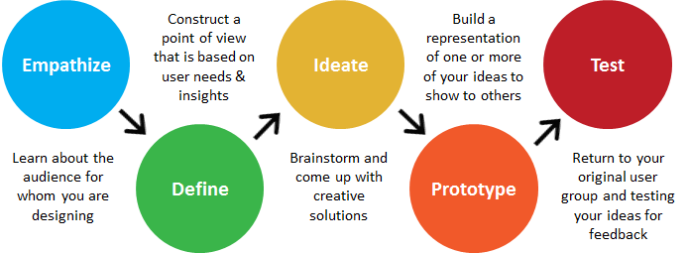

Slide 18
Wat na dit proces?

Slide 19


Slide 20
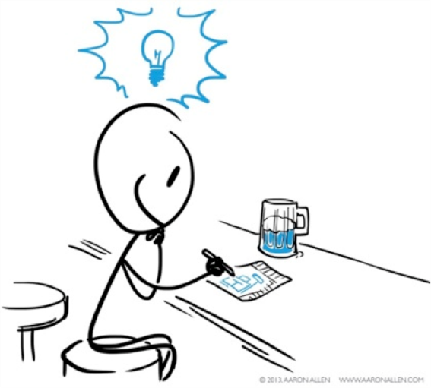

Slide 21
Vragen? pieter.vandekerkhof@uhasselt.be

